Slide 1
Volunteer Opportunities for Employees

Slide 2
What Is Operation Give Back?
Employee volunteer program
Coordinated by Brian Sarkar, Practice Manager
Opportunities to volunteer with fellow employees
Do good
Feel good!
Three days scheduled each year

Slide 3
2021 Give Back Days

Slide 4

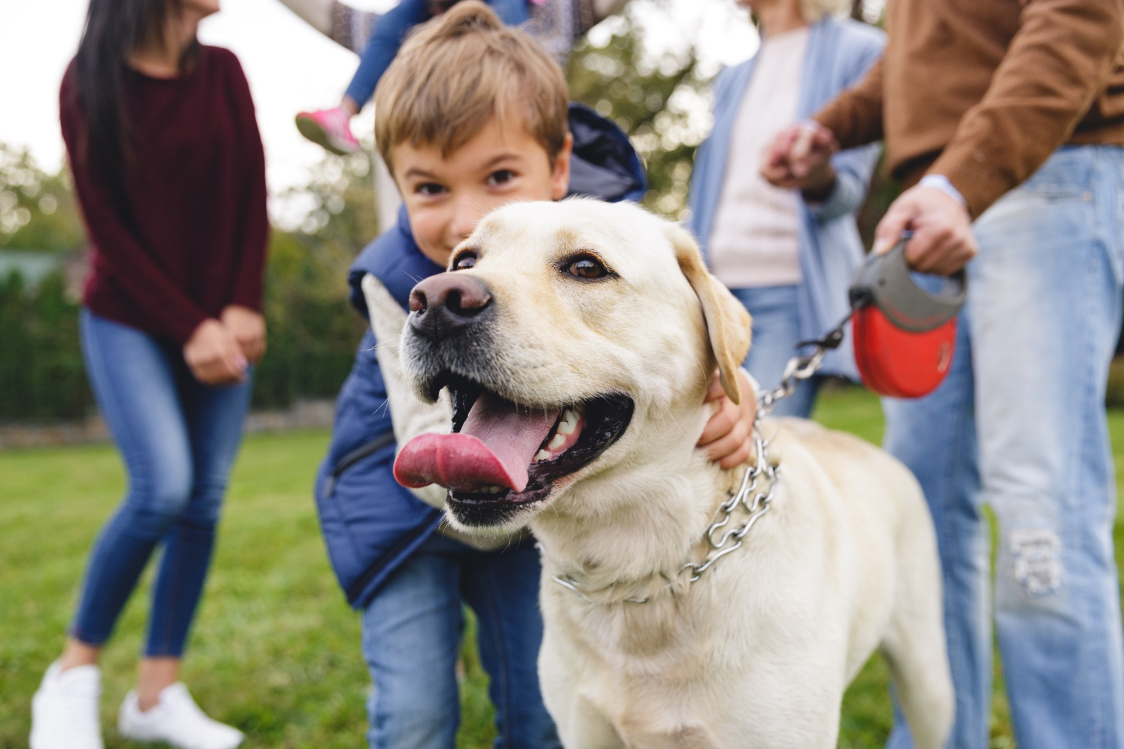

Slide 6
Sign Up Today!
Brian Sarkar b.sarkar@wvh.example.com
or
Tereza Goncalves t.goncalves@wvh.example.com

